Slide 1
My machine learns by itself now! Or does it? https://github.com/signavio/tech-talk-2017-08-24
André Lücke, Signavio GmbH

Slide 2
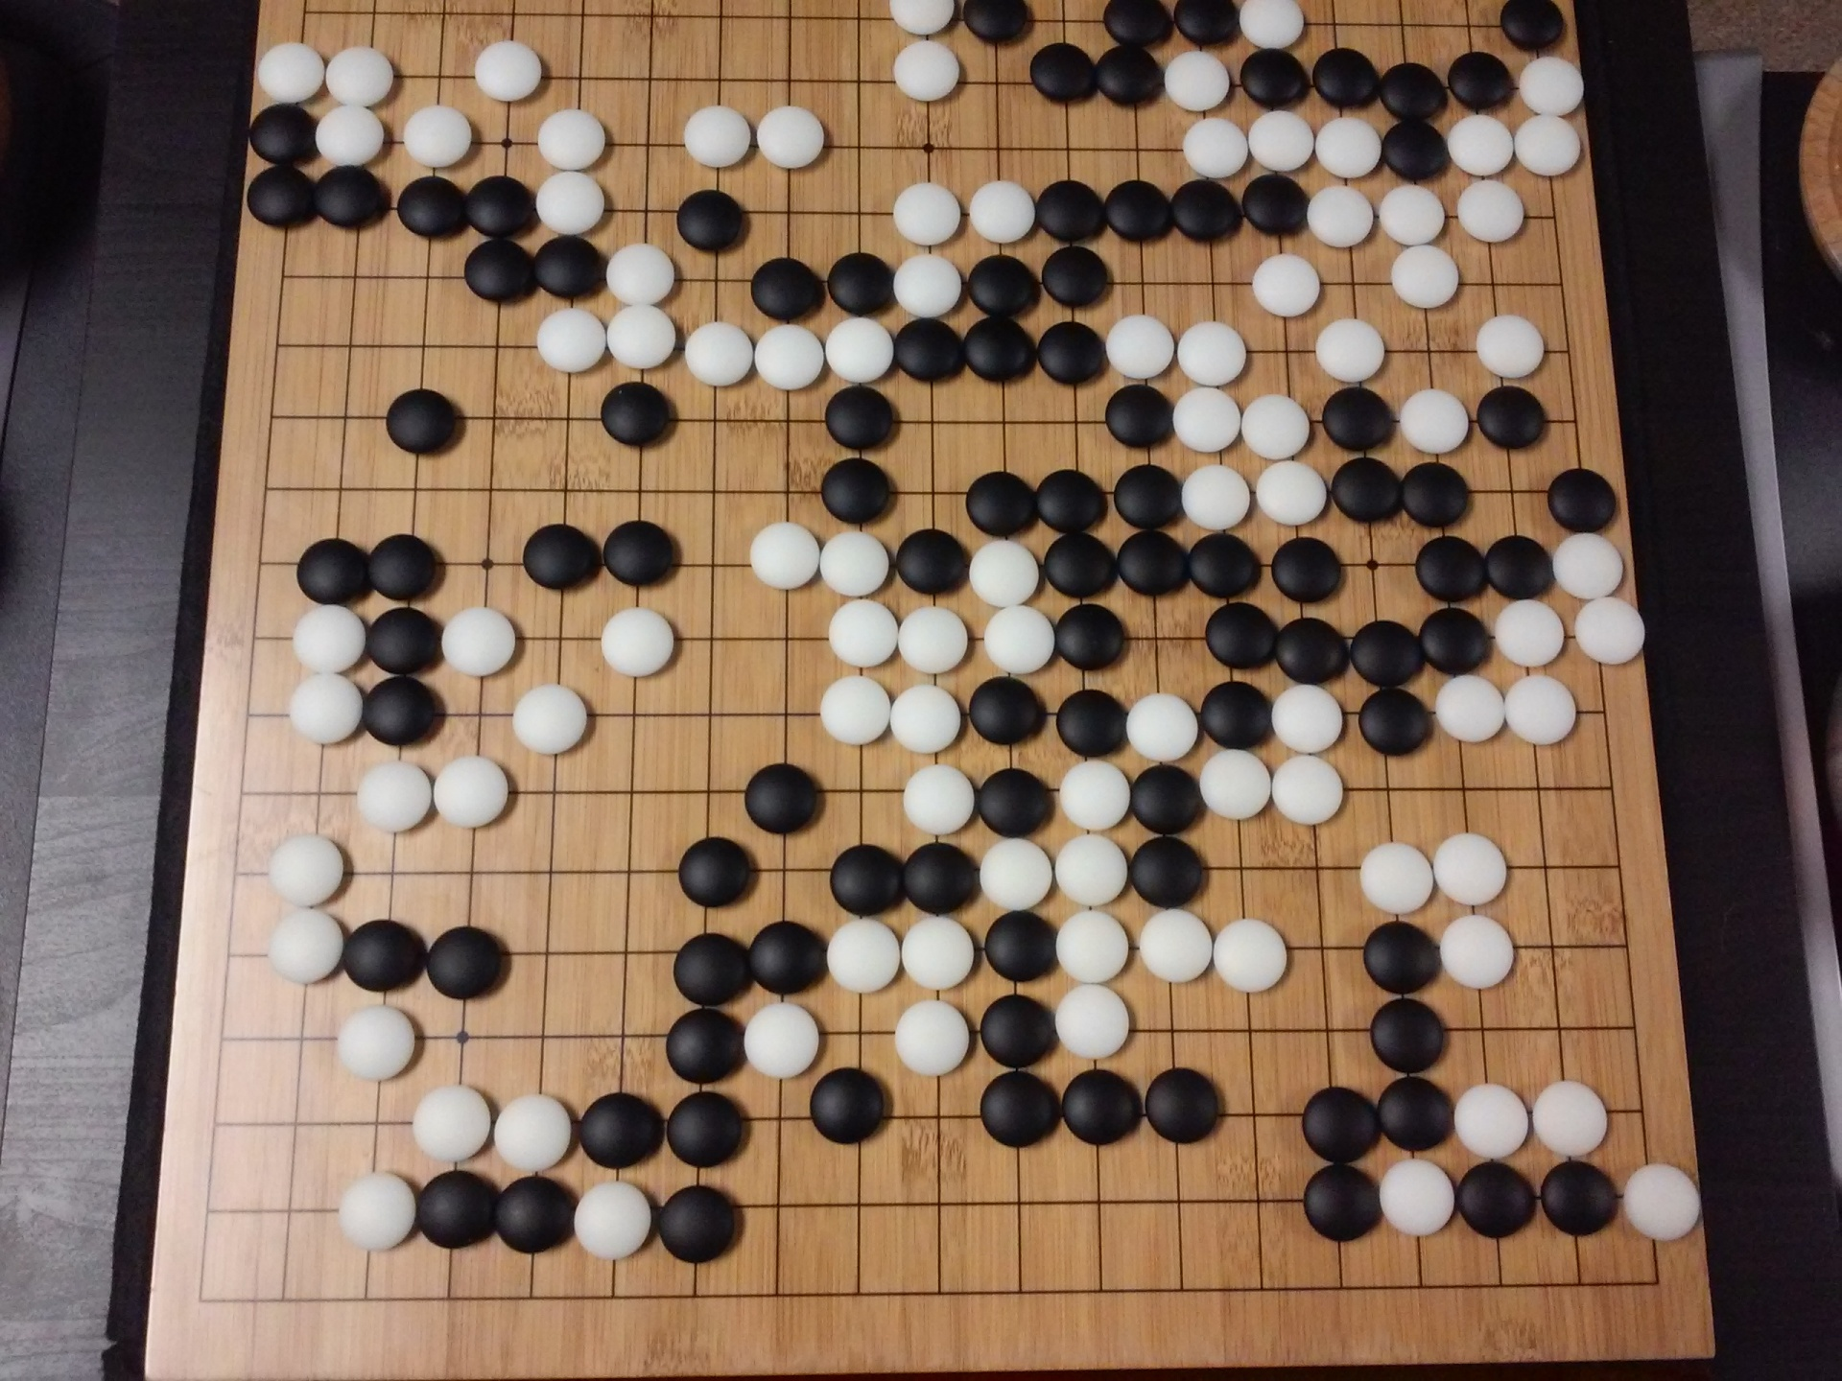
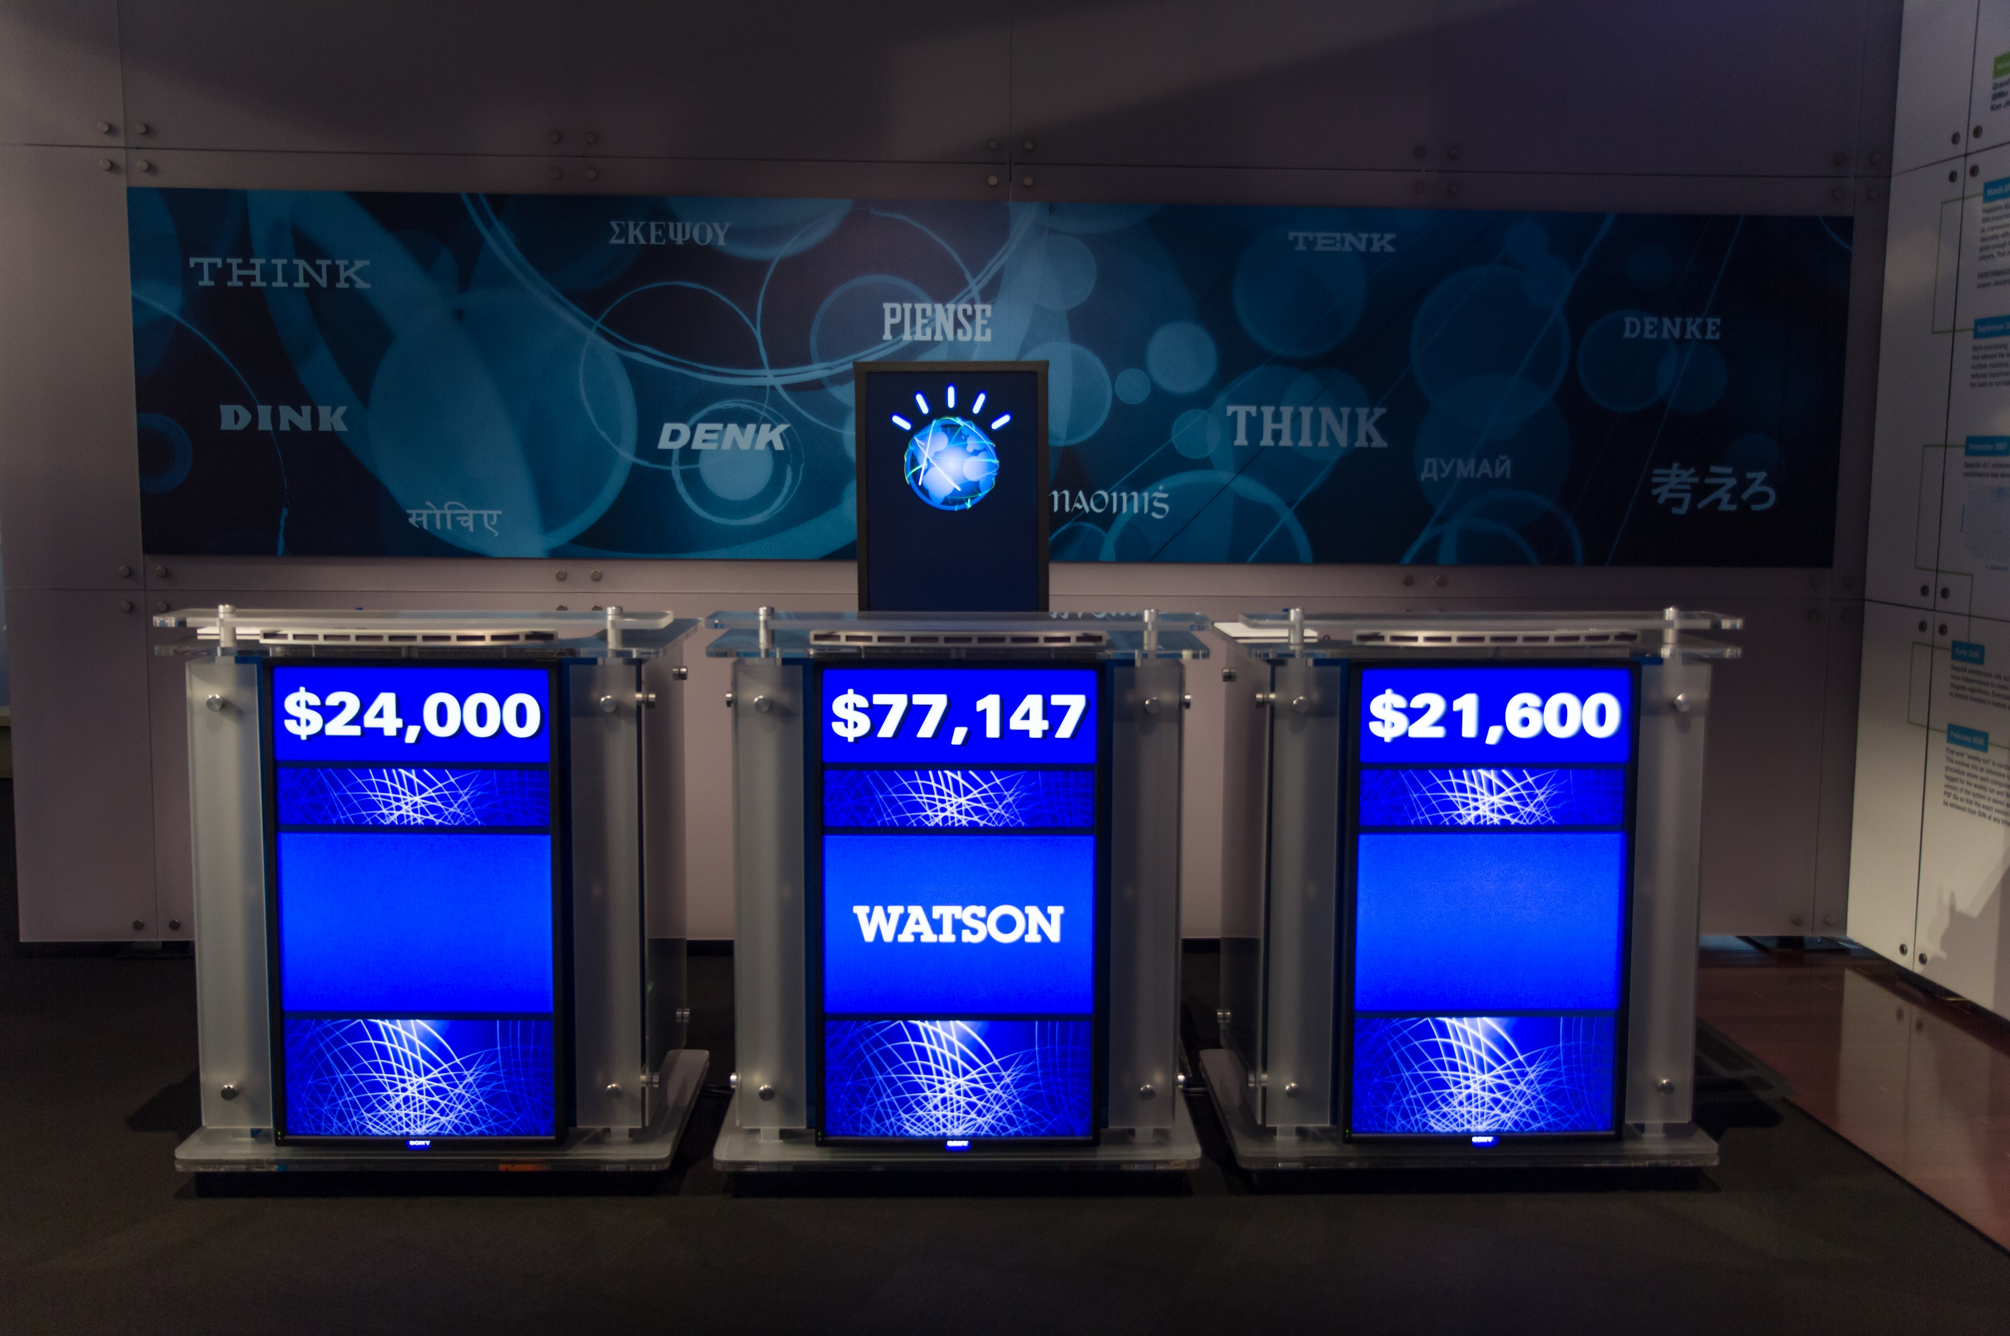
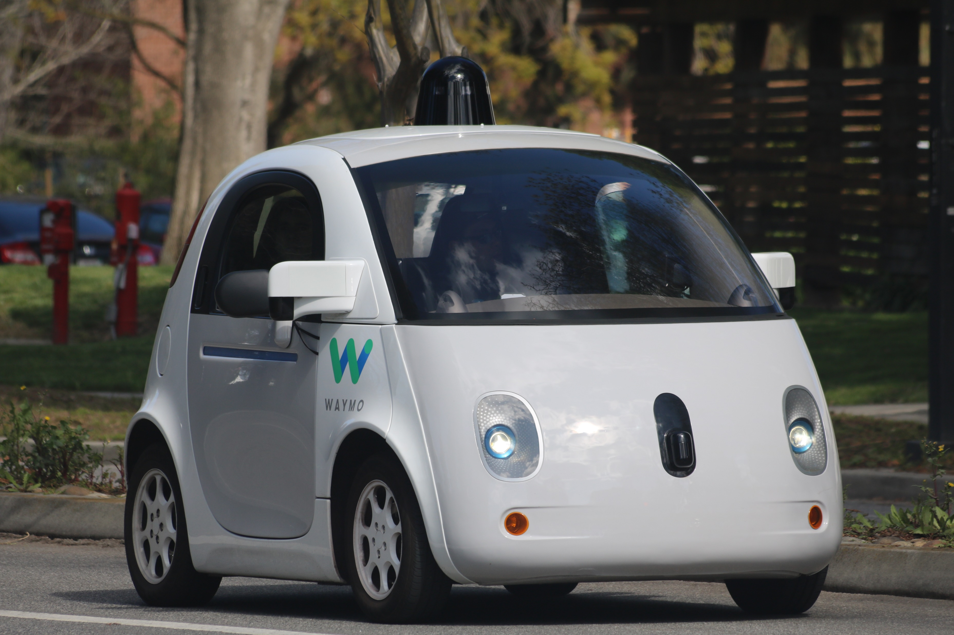
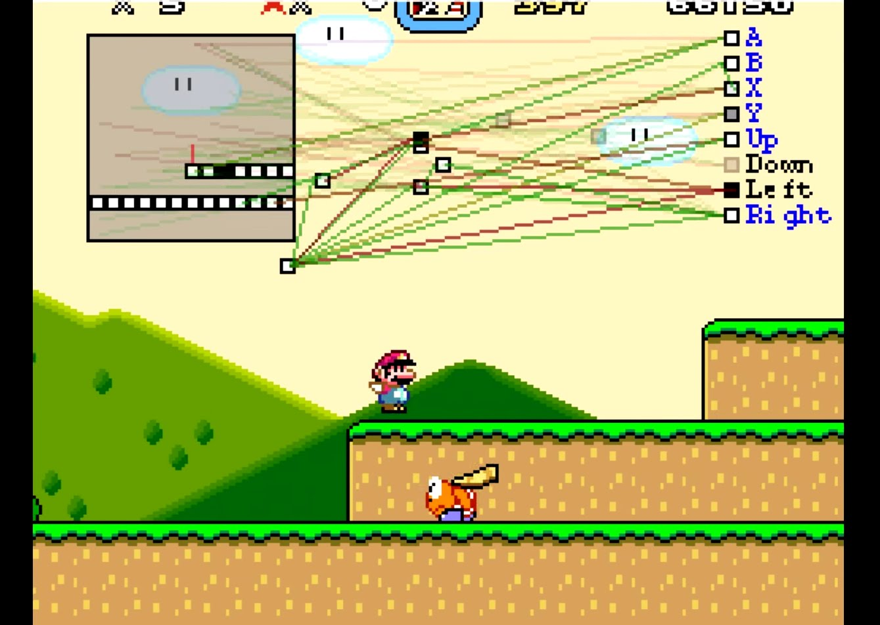
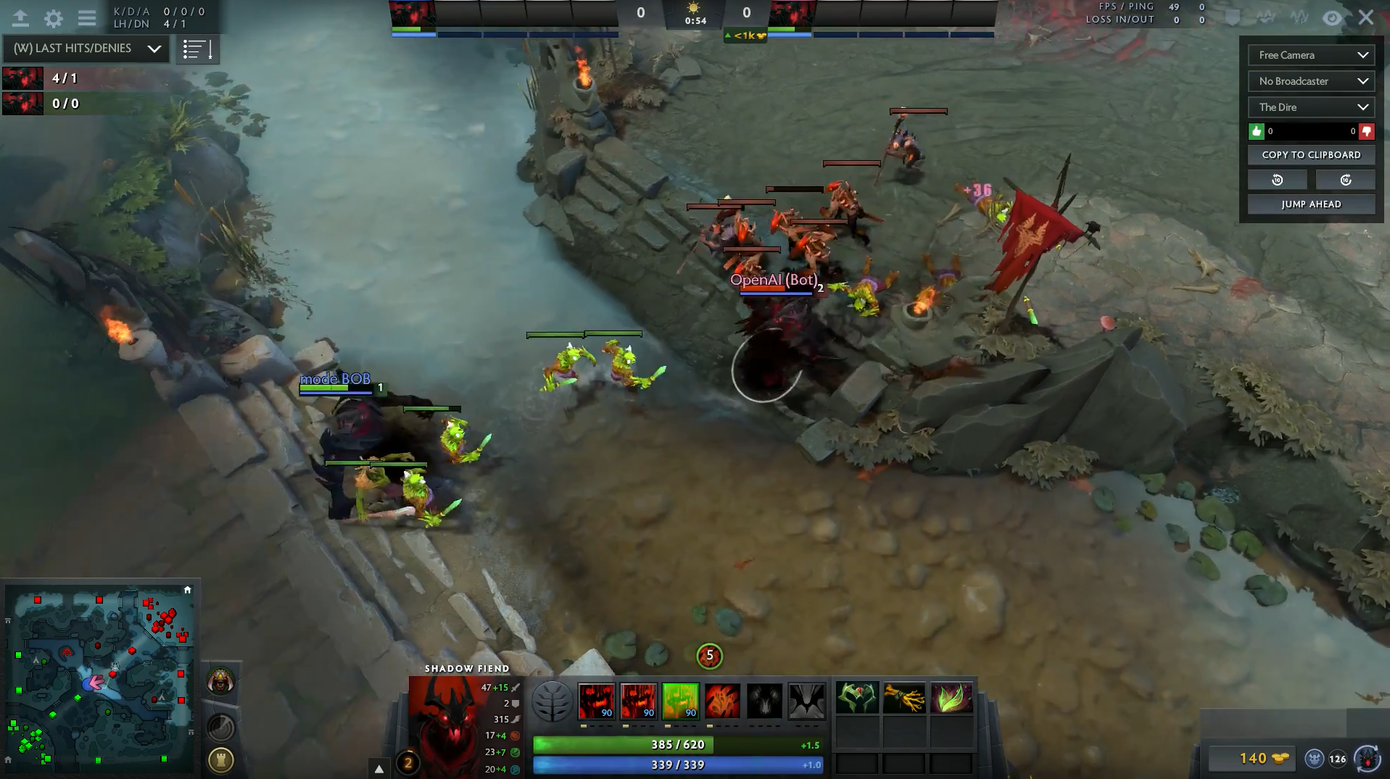
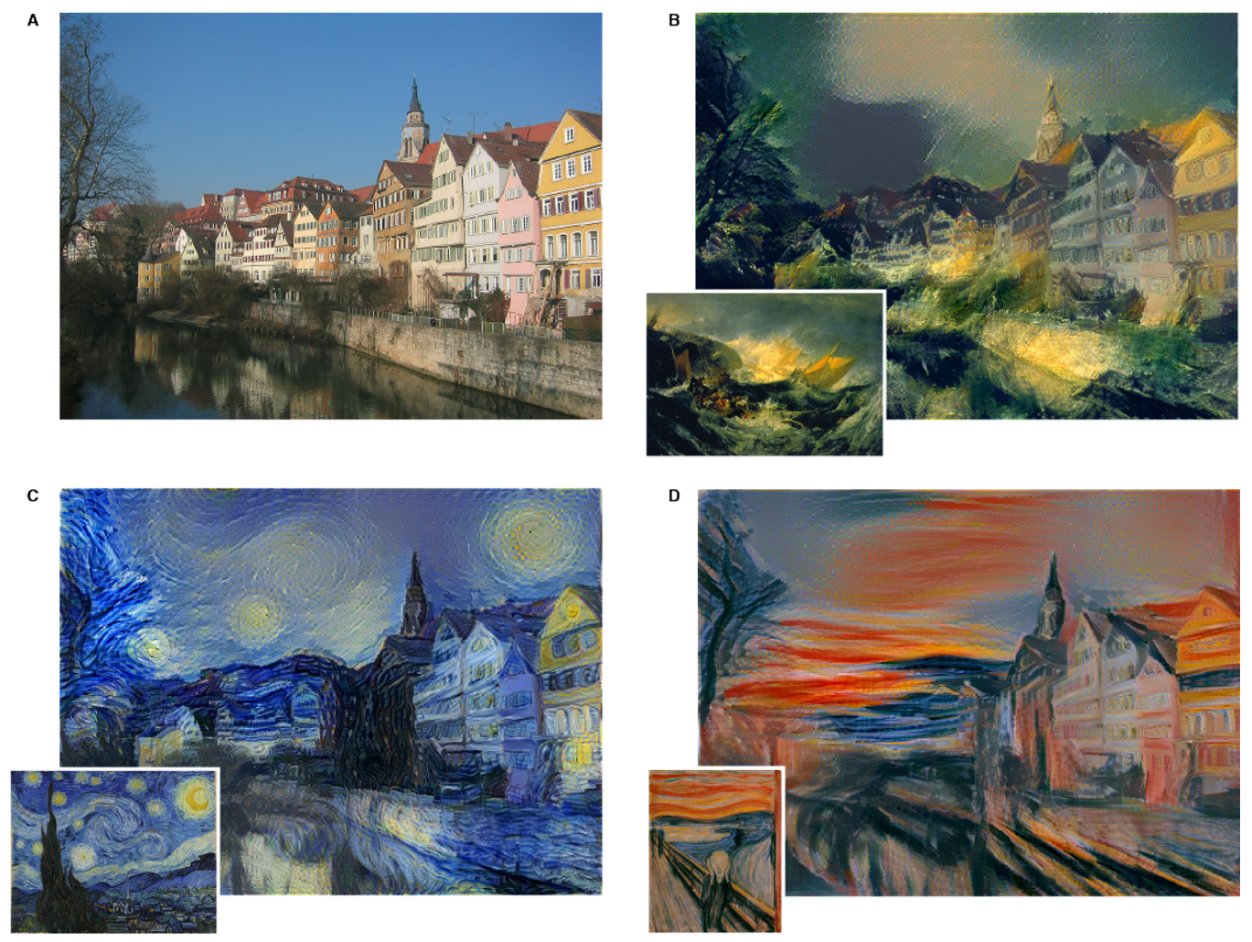
Artificial Intelligence

Slide 3
AI vs Machine Learning
Chess Engine
Artificial Intelligence
Recommendation System
Machine Learning
Image Classification
Deep Learning

Slide 4
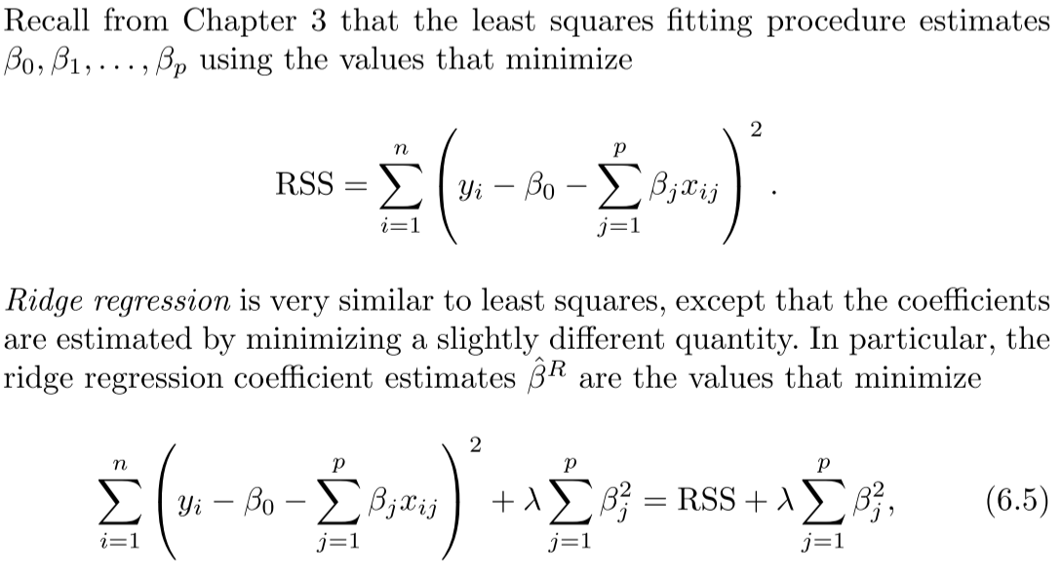
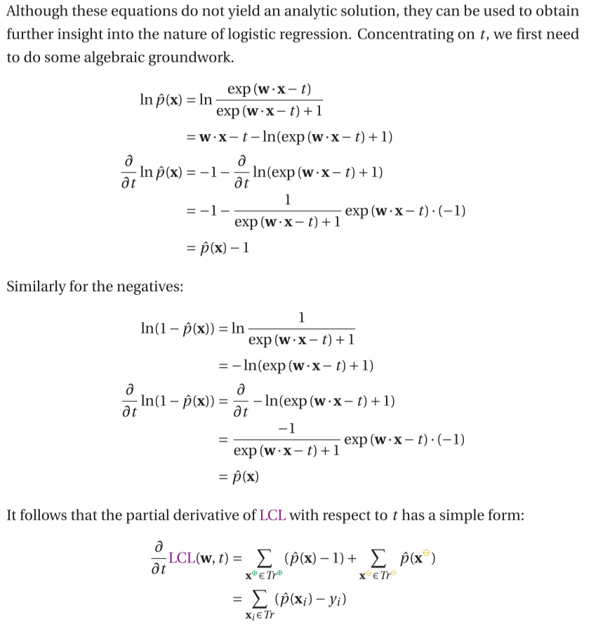
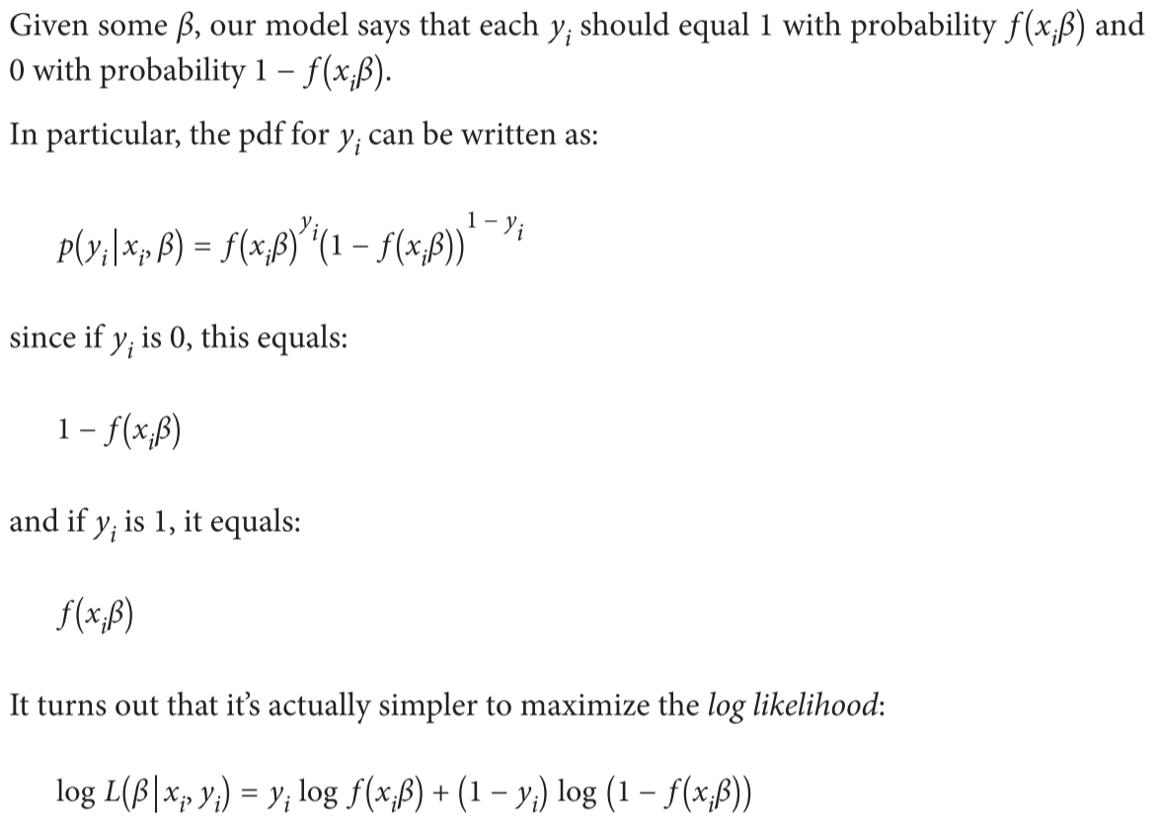
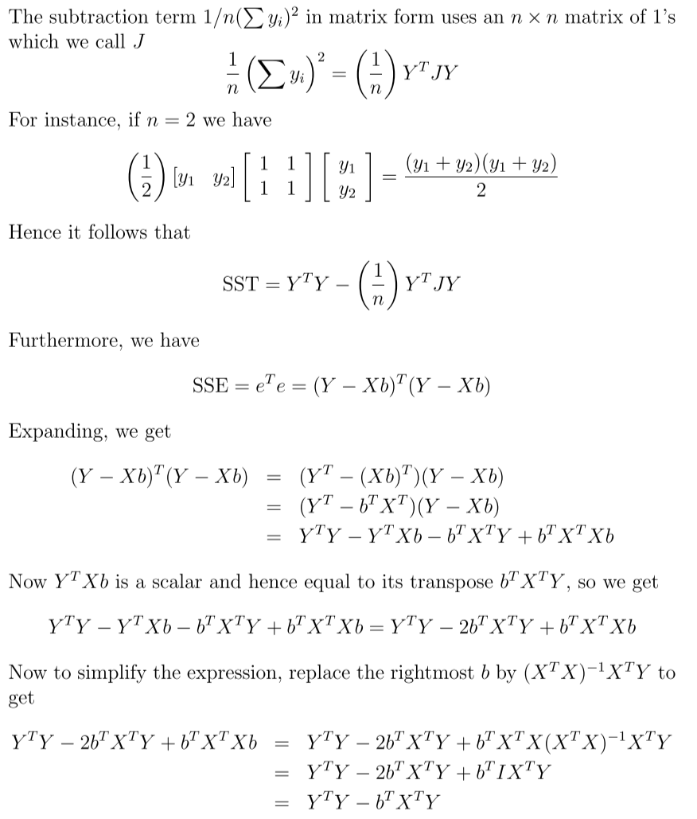
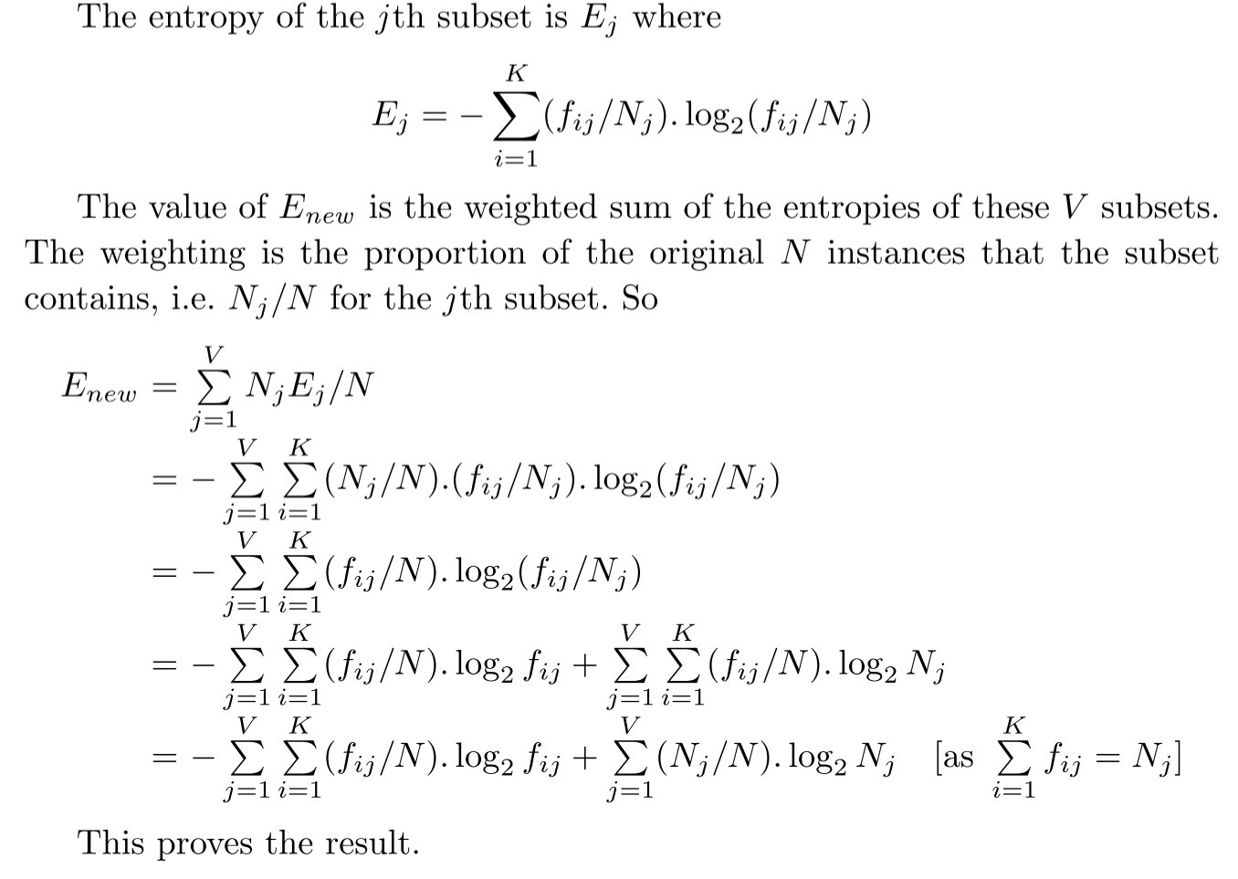
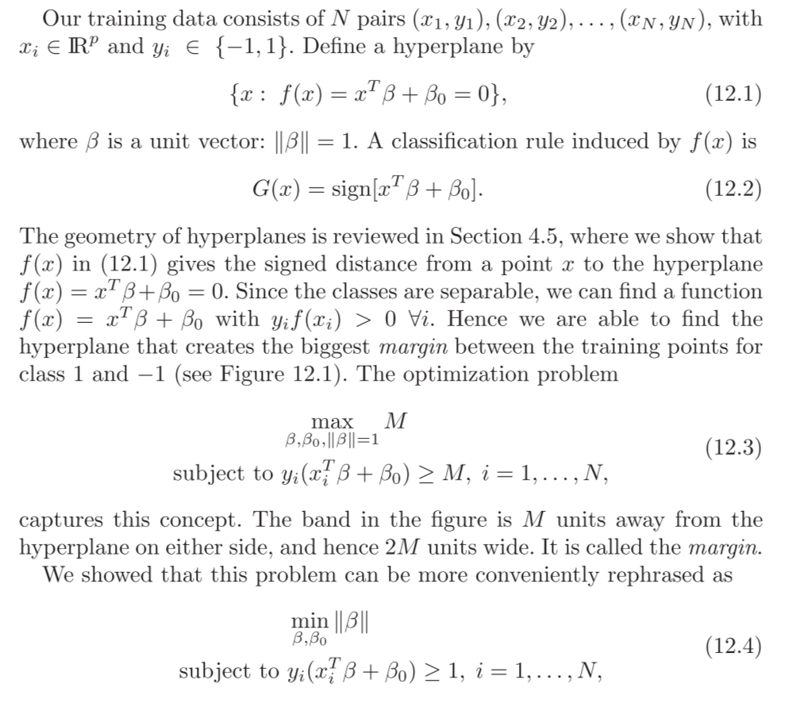
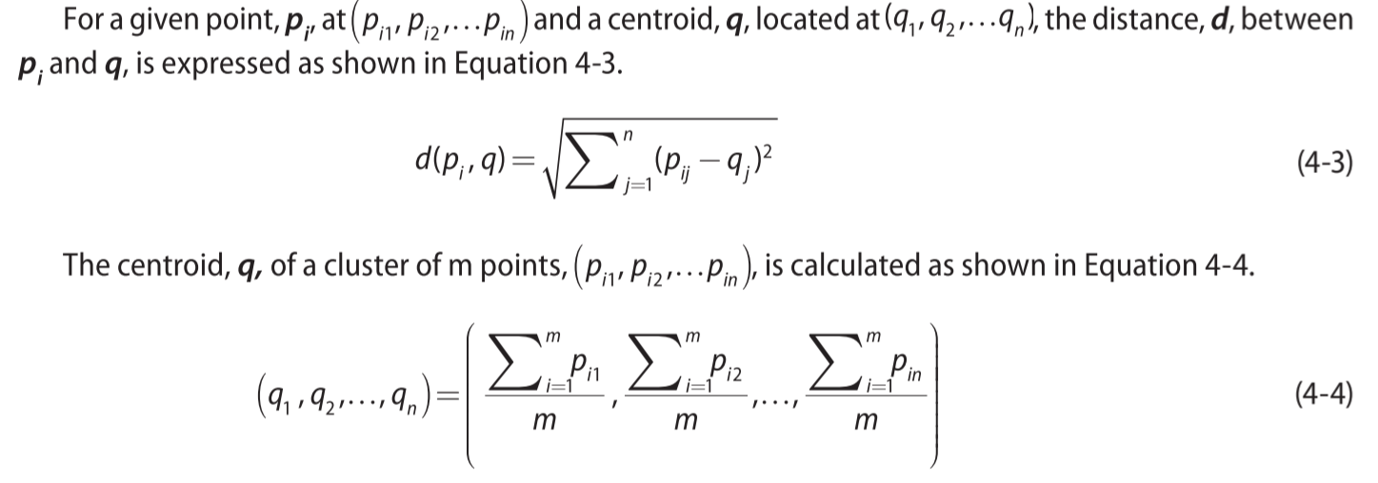
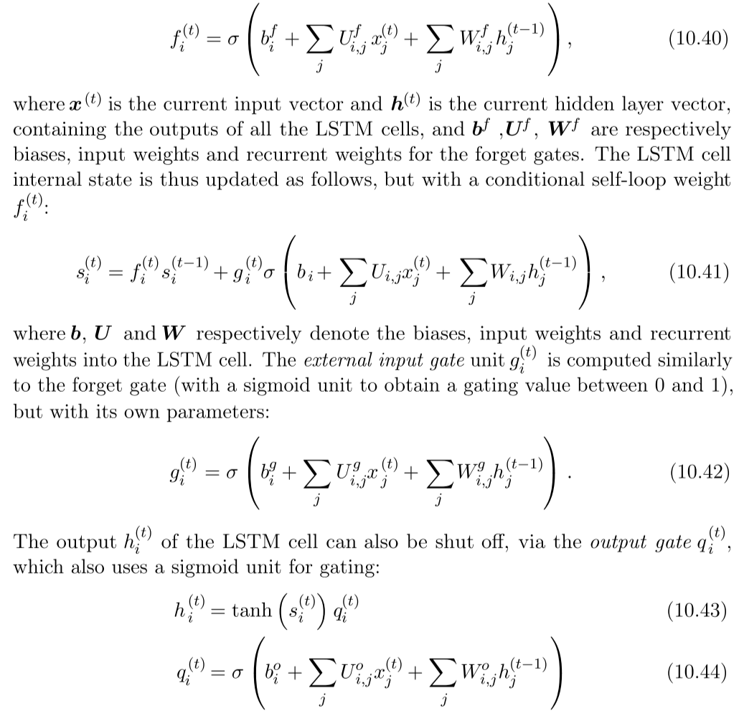
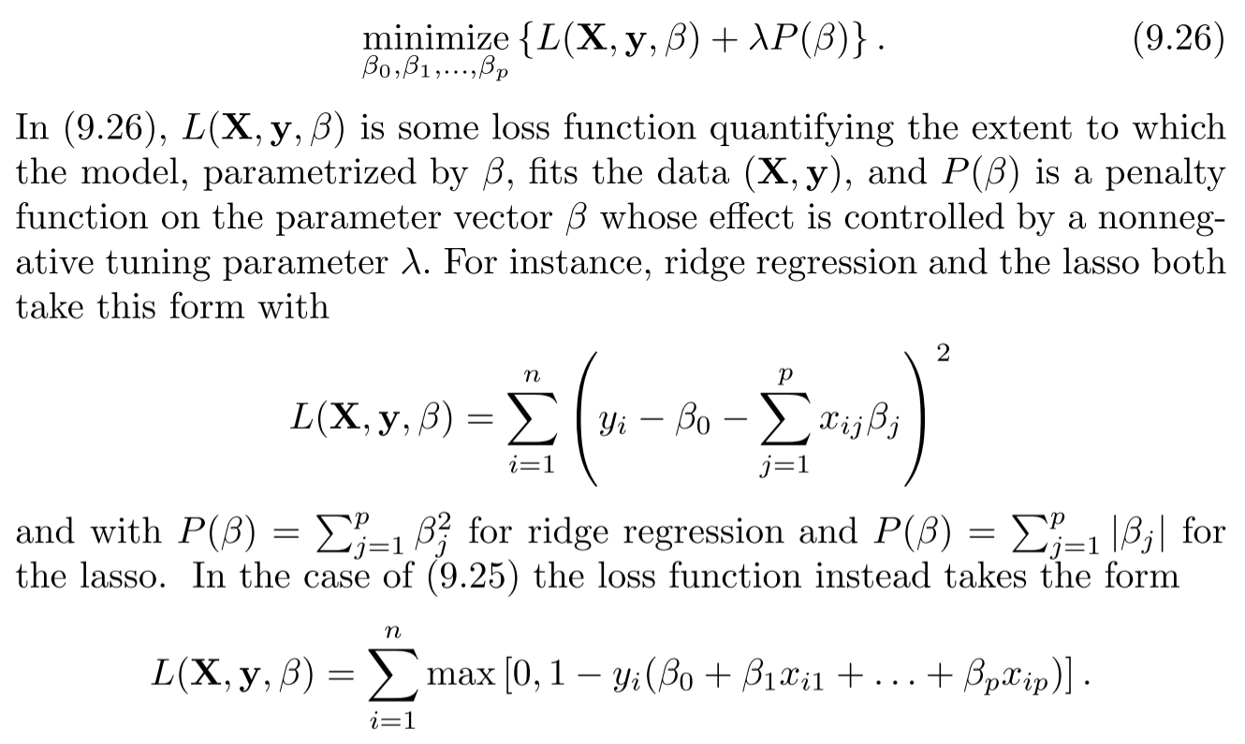
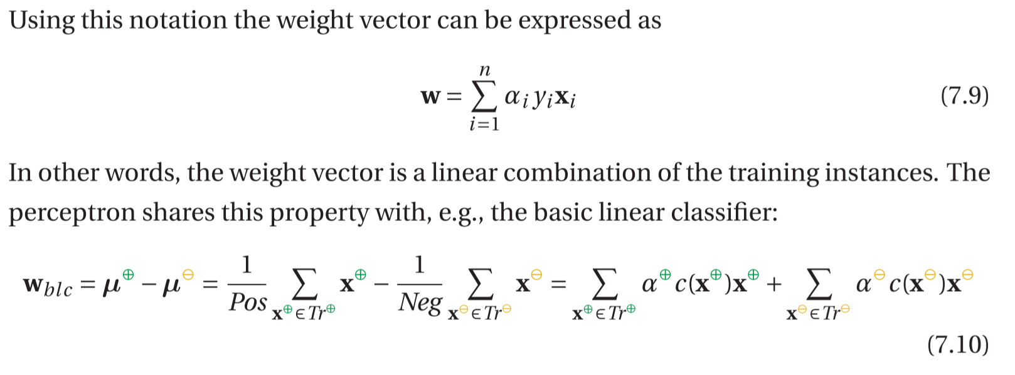
Machine Learning Literature

Slide 5
Types of Machine Learning
Supervised
Input data + labeled output data
Spam Detection
Unsupervised
Input data (no labels!)
Clustering
Reinforcement
Agent in environment, action -> reward
AlphaGo

Slide 6


Basic terms in (Supervised) Machine Learning
Goals
Data structure
Prediction
Input
Features
Predictors
Dependent
X
Output
Target
Response
Independent
Y
Age | Sex | Fare | Survived
60 | M | 50 | No
18 | F | 95 | Yes
Observation
Instance
Inference
(Patterns, Rules)
Problem types
Classification
Categorial (e.g. True/False, Dog/Cat/Horse)
Regression
Numerical (e.g. Revenue, Execution Time)

Slide 7
Machine Learning process
Get Data
Select
Prepare Data
Clean
Score
Build Model
Evaluate
Tune
Scale
Engineer
Combine
Select
Combine
Compare

Slide 8
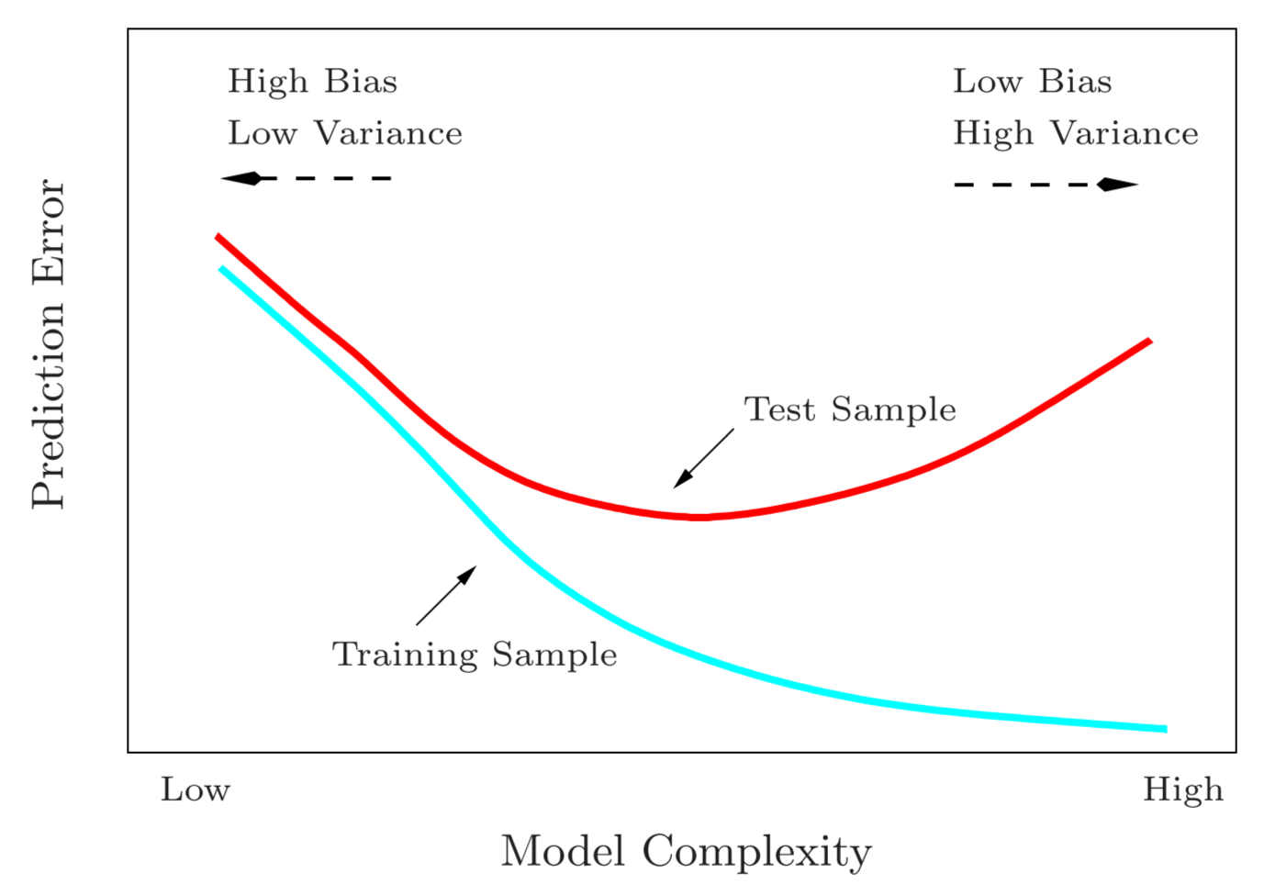
Evaluation
Underfit
Optimal Fit
Overfit
Bias
The error that occurs when the model is too simple to capture reality
Variance
The error that occurs when the model is too closely aligned to the data
Note: Additionally there will always be an irreducible error which is independent from the chosen model

Slide 9
Splitting the data
Train-Test-Split
Training Set
Test Set
Train-Test-Validation-Split
Training Set
Validation Set
Test Set
3-Fold-Crossvalidation
Validation Set
Training Set
Test Set
Training Set
Validation Set
Training Set
Training Set
Validation Set

Slide 10
Information Bleeding
(a.k.a Data Leakage, Contamination)
Wrong
Correct
Learn
Split
Training Set
Training Set
Test Set
Apply
Learn
Training Set
Training Set
Test Set
Split
Apply
Training Set
Test Set
Training Set
Test Set
Contains information
about the test set now
Train
Train
Training Set
Test Set
Training Set
Test Set
Score
Score
Training Set
Test Set
Training Set
Test Set
Too optimistic

Slide 11
Optimization
What is the
best algorithm?
What are the
best features?
What are the best metrics?
Success Factors
Data
(more data and better quality)
Features
(select, engineer)
Algorithms
(select, combine)
What are the best parameters?
Learn the Data
(What is the best fit?)

Slide 12
Some Algorithms
high
Linear Regression
Decision Tree
ensemble
Naive Bayes
Random Forest
Interpretability
Boosting
K-Nearest Neighbors
Support Vector Machines
(Deep) Neural Nets
low
Complexity / Flexibility
high

Slide 13
Recommendations
Document your intentions and conclusions
Remain sceptical, methodical and unbiased
But stay curious und creative (yes, there‘s a trade-off)
Be aware that each algorithm has a different sensitivity to: scale, outliers, inter-correlations, „curse of dimensionality“
Choose simplicity over complexity

Slide 14

Thank you!

Slide 15
References
Flach, Peter: The Art and Science of Machine Learning
Raschka, Sebastian: Python Machine Learning
James, Gareth; et.al.: Introduction to Statistical Learning
Hastie, Trevor; et.al.: The Elements of Statistical Learning
Bramer, Max: Principles of Data Mining
Madhavan, Samir: Mastering Python for Data Science
Goodfellow, Ian: Deep Learning
Grus, Joel: Data Science from Scratch
https://arxiv.org/pdf/1508.06576.pdf
https://arxiv.org/pdf/1705.07962.pdf
https://machinelearningmastery.com/start-here/
http://scikit-learn.org/stable/tutorial/machine_learning_map/

